Slide 1
Time & Attendance
Manager Guide

Slide 2
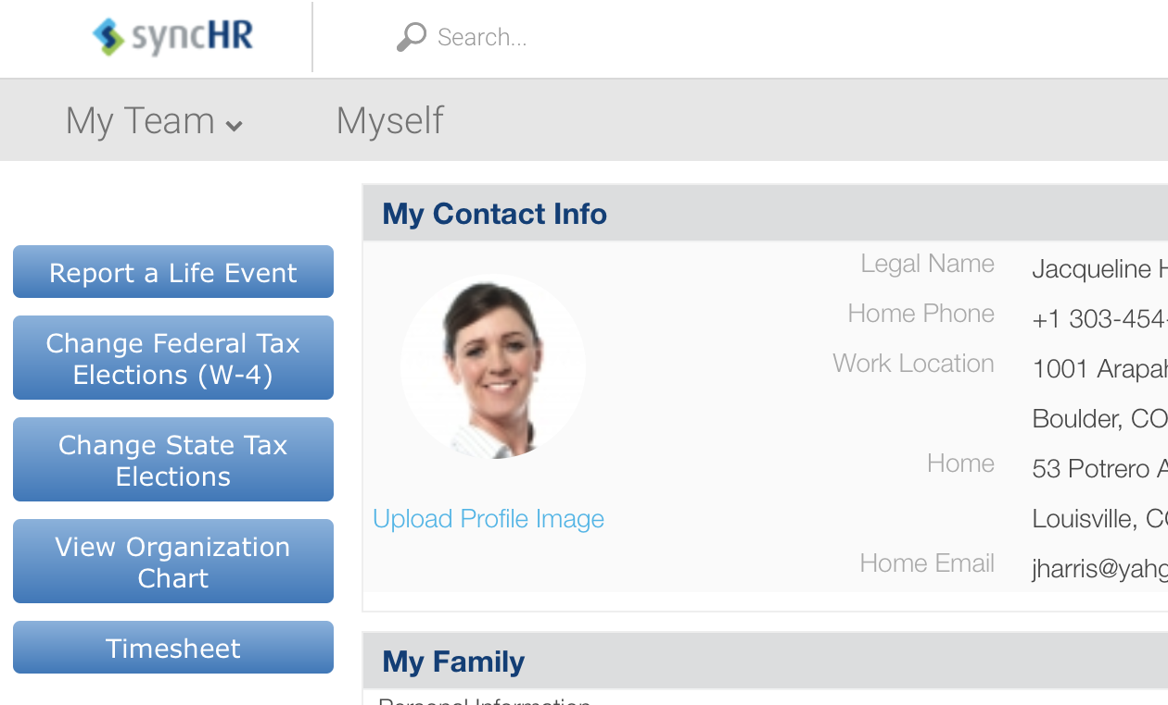
Timesheet Access
Employee Dashboard
Timesheet
To access the Time and Attendance Portal, click on Time Sheet on the navigation panel on your dashboard

Slide 3
Manager Dashboard
Manager Dashboard –TOP
Attendance Board – View is customizable through Edit Tabs
Quickly see who is clocked in or out

Slide 4
Manager Dashboard
Manager Dashboard –MIDDLE
2.
1.
3.
Approve timesheets, time off requests & timesheet change requests
View exceptions (where applicable, and schedules are being utilized)
Access Quick Links
View Missing Punches
4.

Slide 5
Manager Dashboard
Manager Dashboard -BOTTOM
Area for note taking:

Slide 6
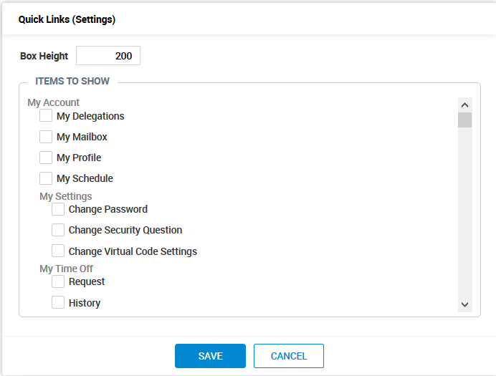
Manager Dashboard
Quick Links
Access reports or views
Add or remove by accessing the settings area (Gear Icon)
Edit the views by selecting or deselecting individual boxes
Scroll down to add/remove
Click Save

Slide 7
Manager Dashboard
Exceptions
Here you can view:
Missing punches
Early or Late arrivals
Long shifts

Slide 8
Manager Dashboard
Missing Punches
View/Edit Missing Punches
To edit a punch, click on the timesheet icon
The timesheet will open allowing you to make adjustments

Slide 9
My Mailbox
My Mailbox/To Do’s
Here, you can:
Access notifications regarding time off requests, time sheet approvals, etc.
Access your to do list
Note: You can also access your mailbox by clicking My Account, My Mailbox

Slide 10
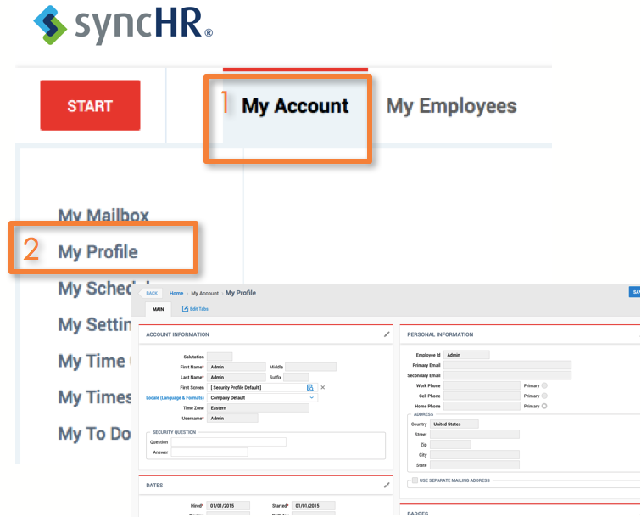
My Profile
My Account
My Profile
This area directs you to a screen showing you all of your set up information. You can also view your personal accrual balances from this window
Click My Account
Click My Profile

Slide 11
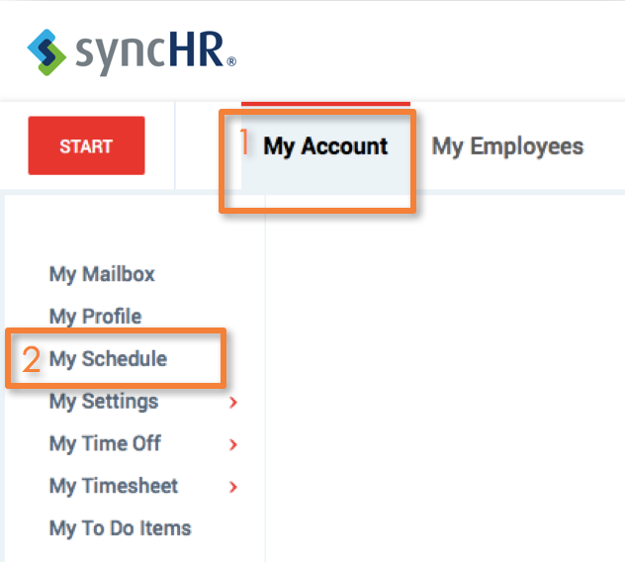
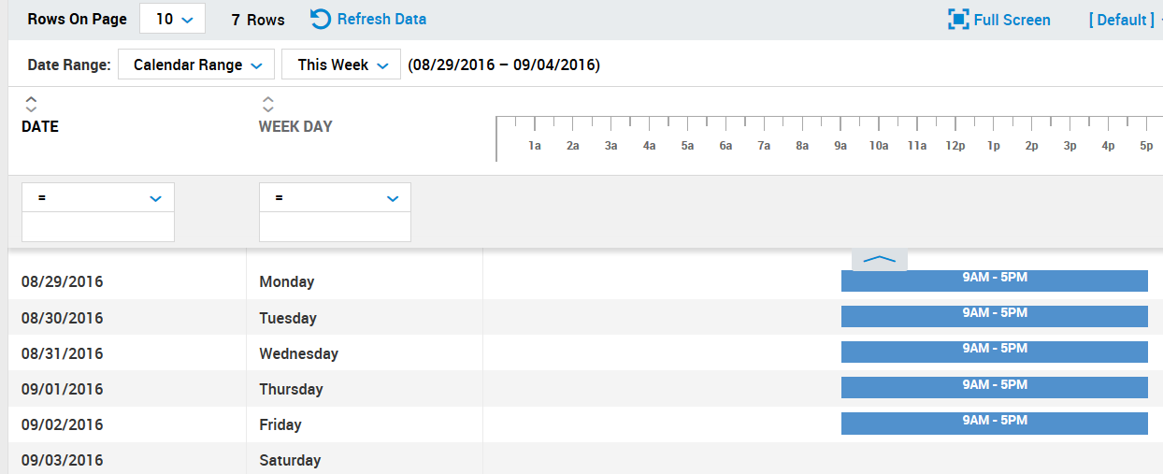
My Schedule
My Account
My Schedule
Click My Account
Click My Schedule

Slide 12
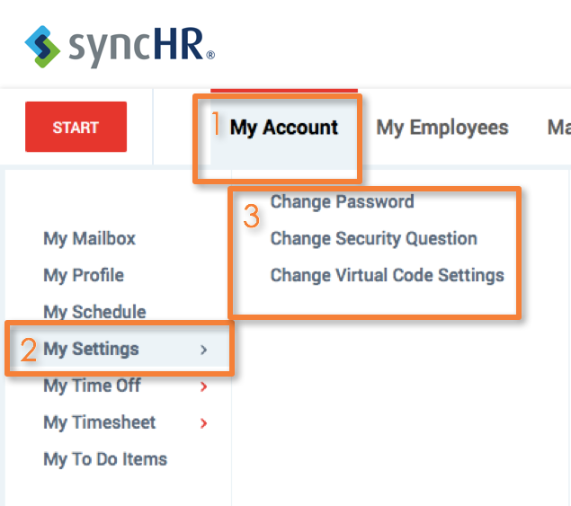
My Settings
My Account
My Settings
Here you can change your password (This only applies to the Mobile app, TotalHRWorks)

Slide 13
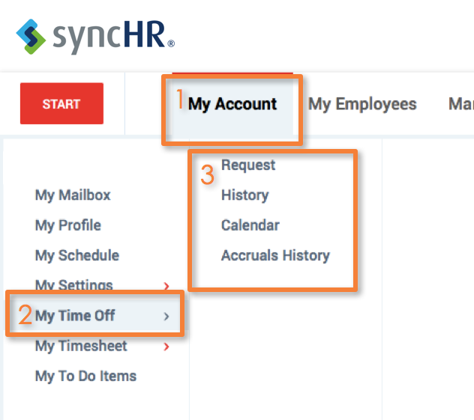
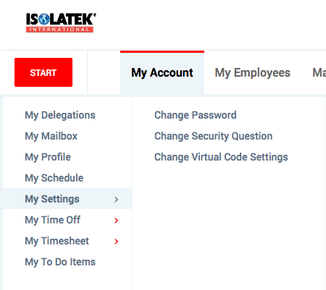
My Time Off
My Account
My Time Off
Here, you can view the time off calendar, accruals history, and make your own personal time off requests

Slide 14
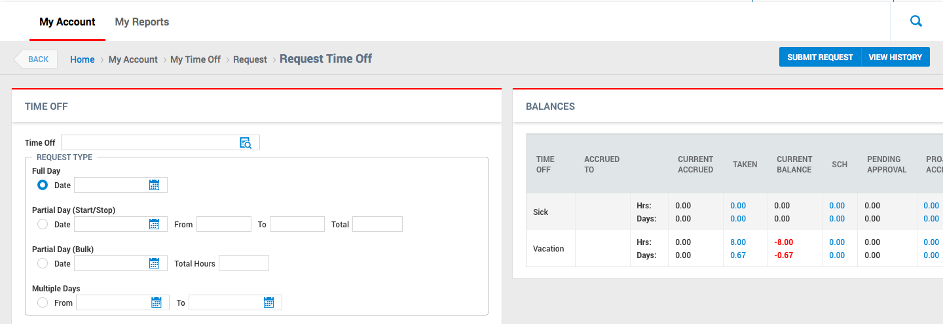
My Time Off
Request Time Off
The screen refreshes:

Slide 15
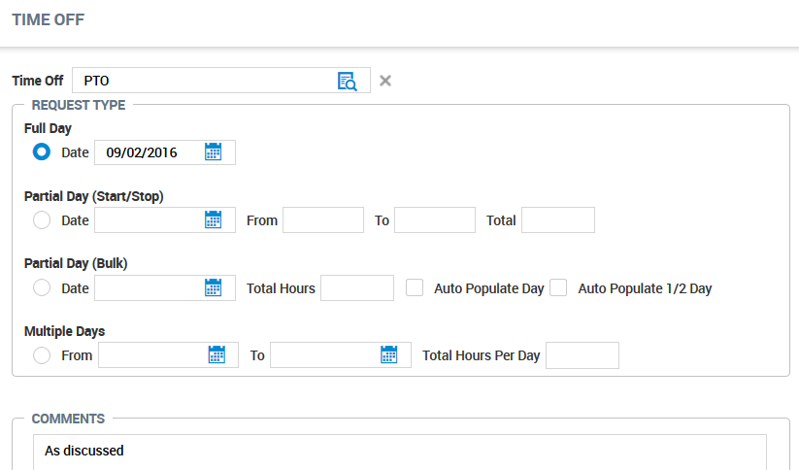
My Time Off
Request Time Off
Enter details
Enter Time Off Type
Enter Request Type (Full day, Partial Day, Multiple Days)
Enter comments, if necessary
Submit Request (Note: Pending requests appear at the bottom of the page)

Slide 16
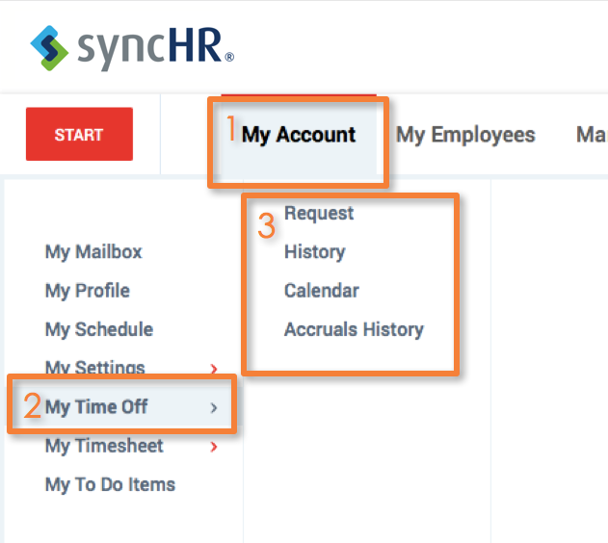
My Time Off
My Time Off Balances
My Accrual History
Here you can view your Time Off Balance detail
Click My Account
Click My Time Off
Click Accruals History

Slide 17
My Time Off
My Time Off Balances
On the right side of the time off screen, you can view your balance detail

Slide 18
My Time Off
Recent Requests
At the bottom of the Time Off page, recent requests will appear. If the Request State is “NEW”, it can be deleted, if necessary.
You can also filter a search of requests by utilizing the fields at the top.

Slide 19
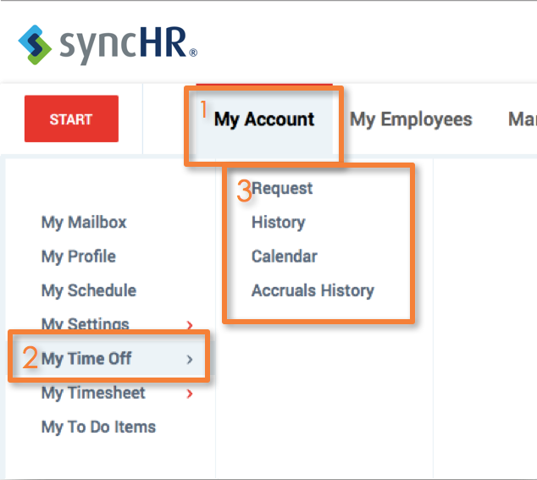
My Time Off
My Account
My Personal Calendar
Click My Account
Click My Time Off
Click Calendar

Slide 20
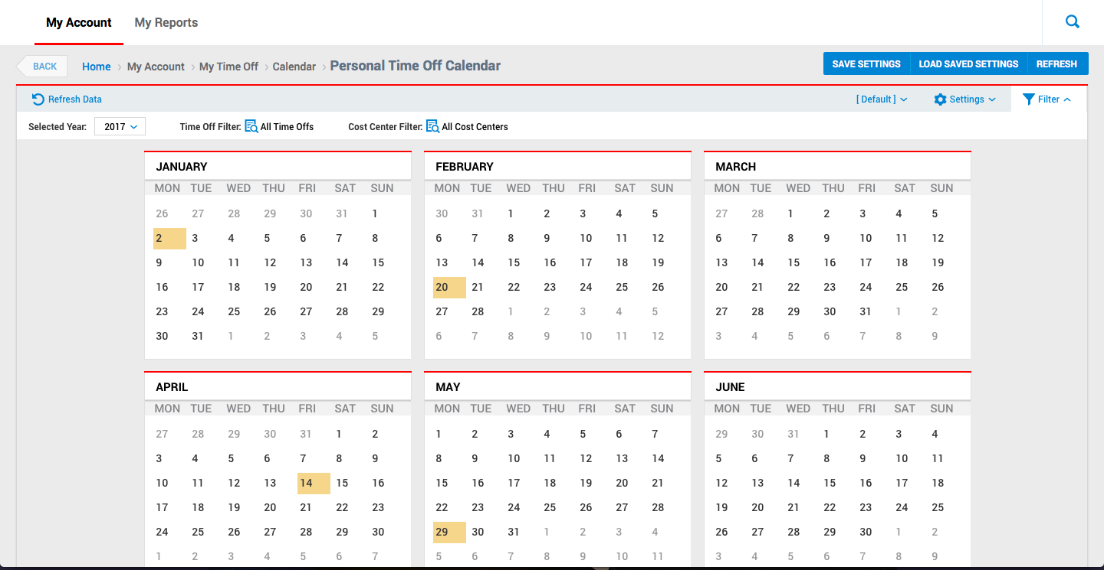
My Time Off
My Account
Calendar
The screen will refresh to show you the company calendar
You can filter by year, approved time off, and cost centers
Click HOME at any time to go back to your Time Sheet

Slide 21
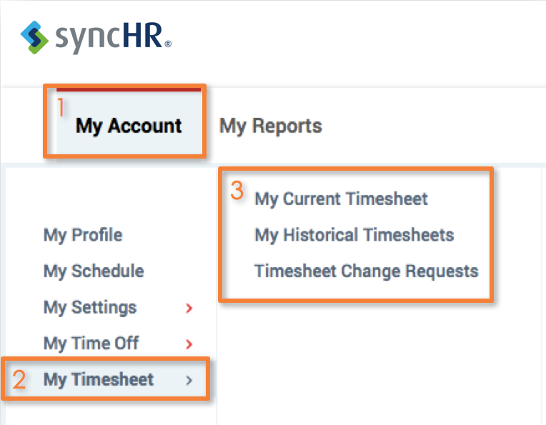
My Timesheet
My Account
My Timesheet
Click My Account
Click My Timesheet
Here, you can access Current, Historical, or Timesheet Change Requests

Slide 22
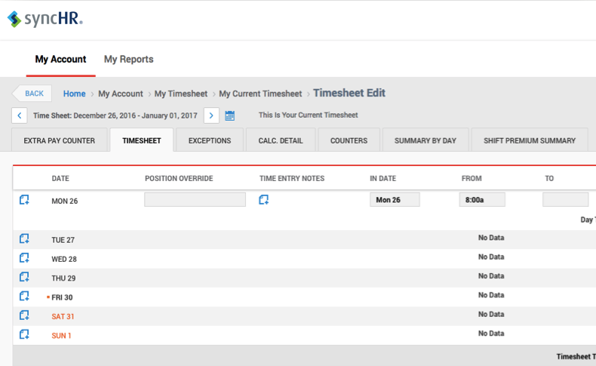
Helpful Navigating Tip
Helpful Tip:
Click your logo or the Home link at the top of the page wherever you are in the system to return to the home page
Click the BACK button to take you to previous pages

Slide 23
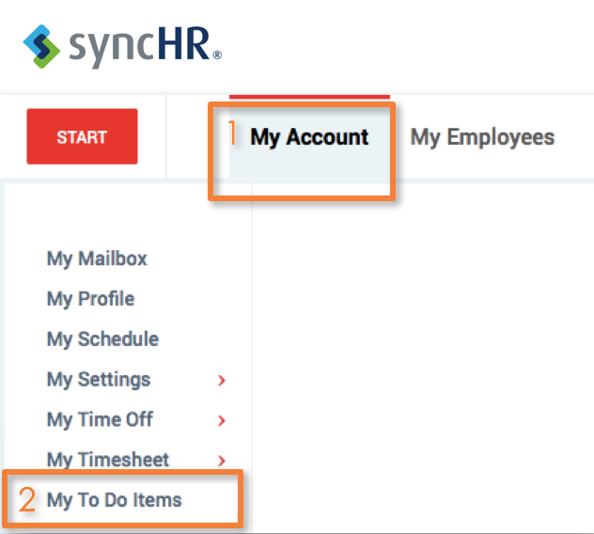
My To Do Items
My To Do Items
Access your To Do Items
Click My Account
Click My To Do Items
Note: You can also access Your To Do Items by clicking on the Bell icon in the top right of every page

Slide 24
My To Do Items
My To Do Items
Here, you can approve time off requests, timesheet change requests and approve timesheets

Slide 25
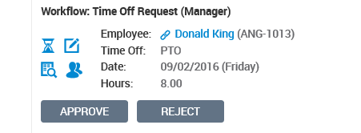
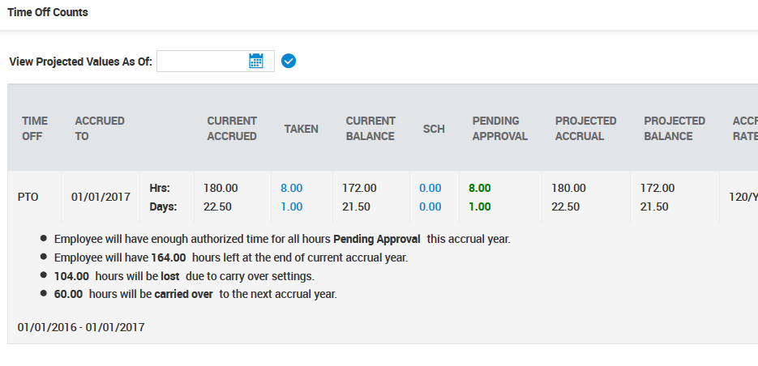
My To Do Items
Time Off Request
View Balances
Click the Time icon
A screen appears showing the employee PTO balance detail
Notes:
Can remove the bullets under the Time off counts for employee view

Slide 26
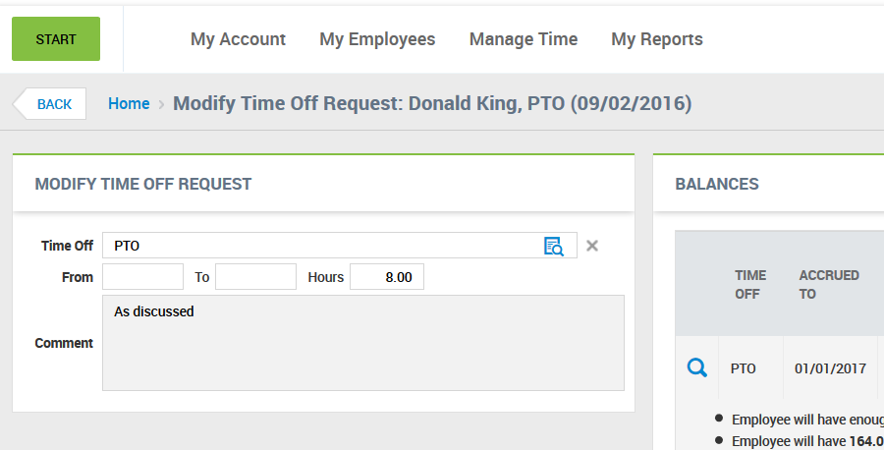
My To Do Items
Time Off Request
Modify Request
Click Edit icon
A screen appears allowing for the edit to the request and shows the PTO balance detail

Slide 27
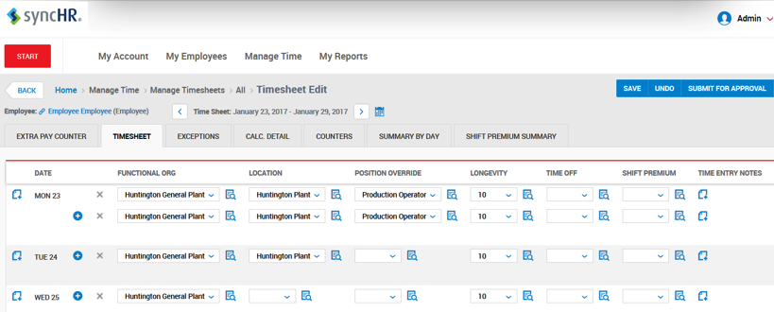
My To Do Items
Time Off Request
Timesheet
Click Timesheet icon
A screen appears showing you the employee’s timesheet

Slide 28
My To Do Items
Time Off Request
Schedule
Click People Icon
A screen appears showing you the schedule to determine coverage needs

Slide 29
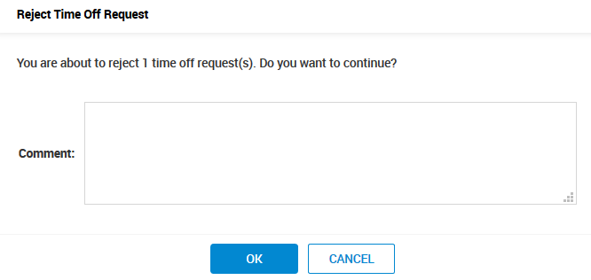
My To Do Items
Time Off Request
Approve or Reject
Once you approve or reject the request, a notification will be sent to the employee
If you choose to reject the request, a box will appear allowing you to add a comment to send to the employee

Slide 30
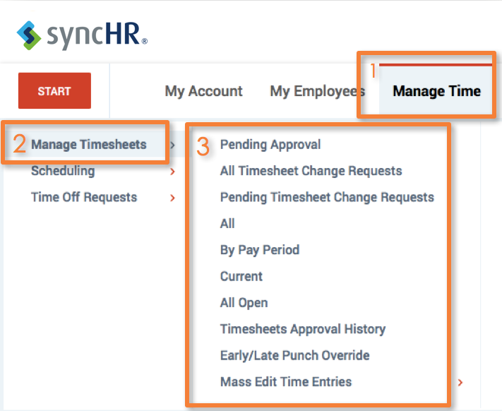
Manage Timesheets
Manage Timesheets
Viewing and Approving Time Sheets
Click Manage Time
Click Manage Timesheets
Select an option

Slide 31
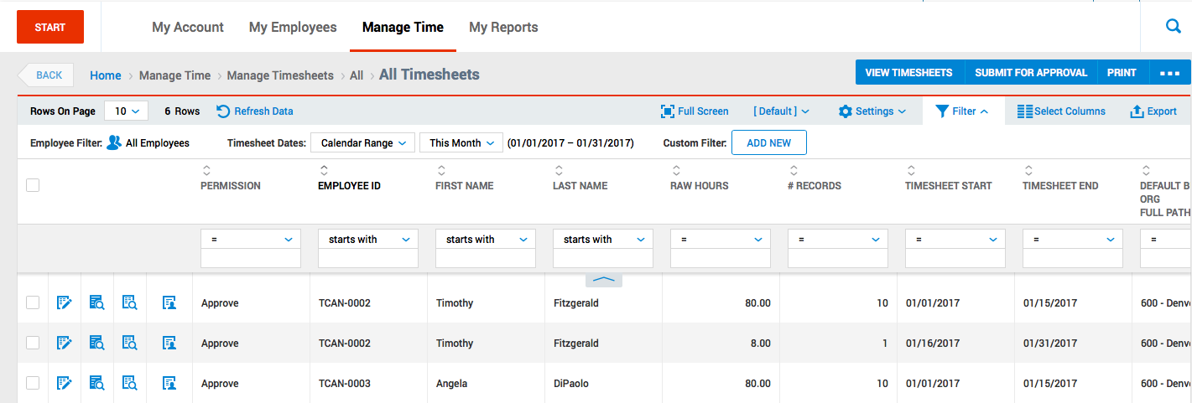
Manage Timesheets
Timesheets
Click the checkbox to select multiple employees
Icons (Left to Right): Edit the Timesheet, View Time Entries/Audit Trail Report, Preview the Timesheet, Employee Information
Click Approve
Select Timesheets

Slide 32
Manage Timesheets
Timesheet
Getting to Know The Employee’s Timesheet
Date – Shows day
Functional Org, Location – Department/Location in which the work time is allocated
Position Override and Time Off– If there is a company holiday, or you have requested time off, this field will show the entry
Longevity – Number of years employee has worked for company

Slide 33
Manage Timesheets
Time Sheet
Getting to Know The Employee’s Timesheet
Shift Premium – Shift that was worked
Position Override Rate – When the employee works a different job with a different pay rate
Time Entry Notes – Notes for overall time period
In Date – Actual day the hours were completed
From vs. To – Clock In/Out times
Raw vs. Calc. Total – Hours actually worked vs. all hours with rules applied
Schedule – Shows actual hours scheduled

Slide 34
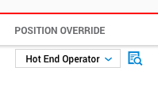
Manage Timesheets
Timesheet
Modifying The Time Sheet
1
2
3
4
5
Add a Note for the particular day in the pay period
Change the Functional Org, or Location
Modify the Position Override if the employee worked at another location on the particular day.
Add a Note for the pay period
Adjust the Clock In/Out times

Slide 35
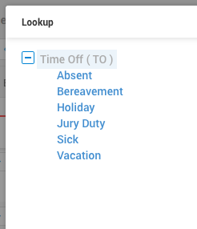
Manage Timesheets
Timesheet
Utilizing Lookup option
When utilizing any of the drop down menus, and the option you are looking for does not appear:
Select the Lookup icon to display all options
Add a Time Entry Note (Optional)
Click Save

Slide 36
Manage Timesheets
Action Buttons
These will change in availability according to the status of the timesheet
Save – Save the edits
Undo – Undo your last action
Approve – Approves the employee’s timesheet
Reject – Rejects the employee’s timesheet
Utilities – Timesheet details, audit trail, reprocess punches, schedule editing, and customized printing
Info – Information about the Time Period
Employee Info – Name, Hire & Start Date

