Slide 1
Employee Self Service

Slide 2
Agenda
Overview
Notifications / Onboarding Tasks
Settings
Dashboard (Edits)
Total Compensation / Direct Deposits
Time and Attendance Portal
Benefits
Life Events

Slide 4
Employee Dashboard

Slide 5
Notifications
If it’s the first time you are accessing the system, you may need to handle some tasks
When you log into Employee Self Service, it is important that you check your notification center. If you have any tasks that require attention, you will see a checkmark and number.
Click on the notification icon

Slide 6
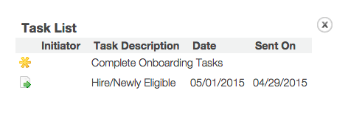
Task List
You will see the following screen:
Click on the yellow “wheel” next to the line Complete Onboarding Tasks

Slide 7
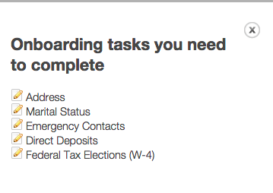
Onboarding Tasks
You will see a navigation screen which will allow you to finish some important tasks required to confirm your status as active
Click on the icon to the left to edit the sections visible in this area to complete your onboarding

Slide 8
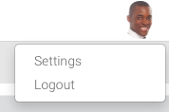
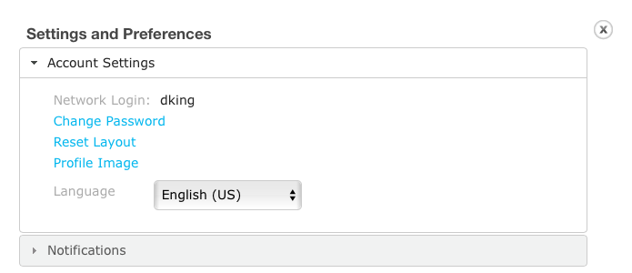
Settings & Logout
To access your settings as well as log out of the system, click the profile image

Slide 9
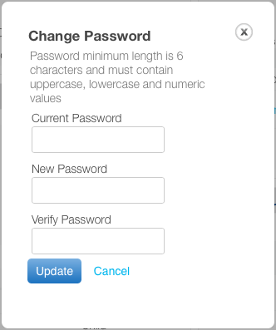
Password

Slide 10
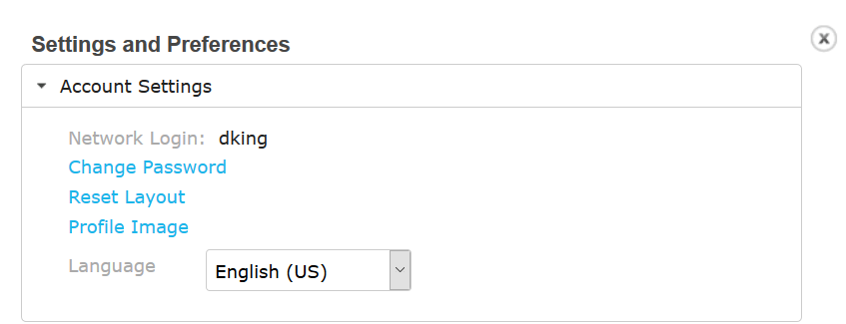
Layout
The main dashboard will appear. You can edit the layout simply by clicking on any grey panel header and dragging it to your preferred location
You can also collapse or expand the panel by clicking the arrow in the header

Slide 11
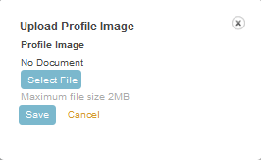
Profile Image

Slide 12
Language

Slide 13
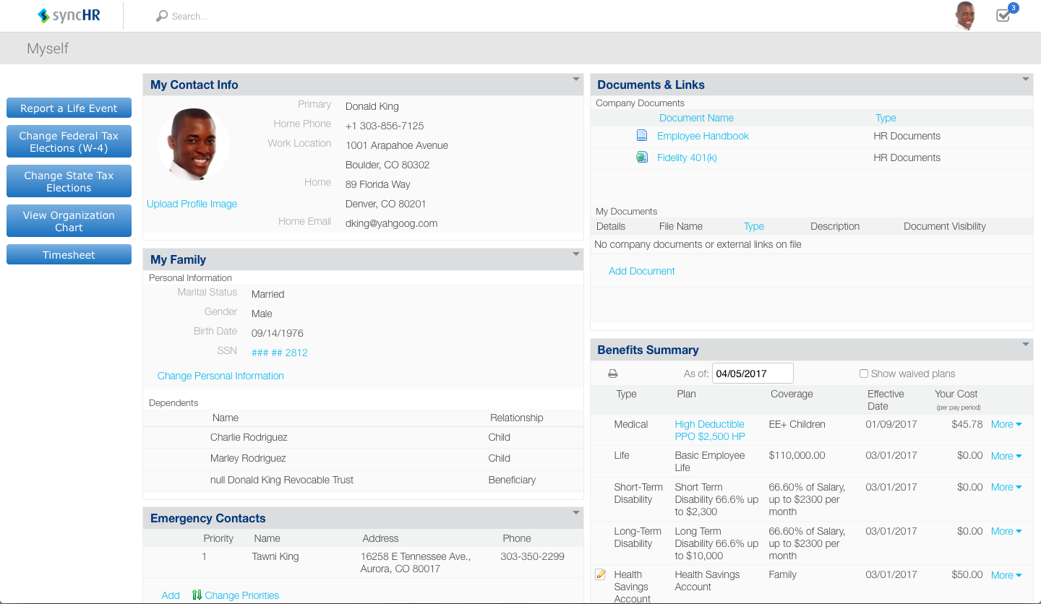
Dashboard
There are many panels on your dashboard
The following slides show you how to edit panels

Slide 14
Changing My Contact Info
Hover over the area you want to add, edit, or delete
Select the corresponding icon, and complete the fields that are displayed.

Slide 15
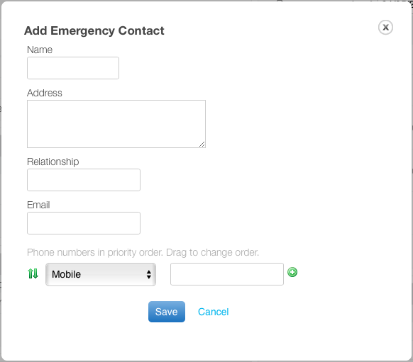
Emergency Contacts

Slide 16
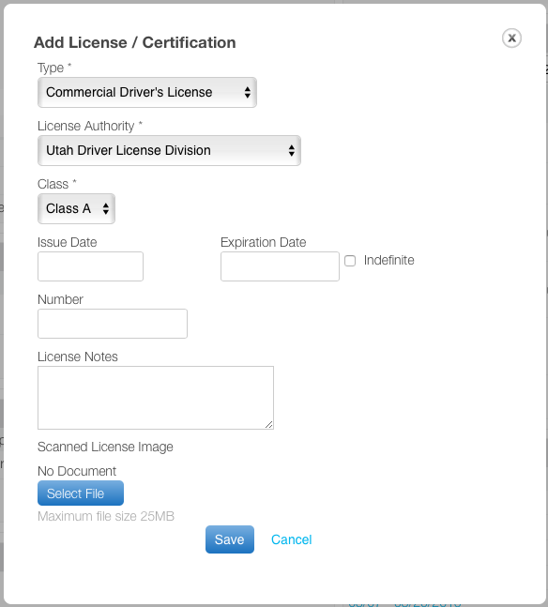
Licenses & Certifications

Slide 17
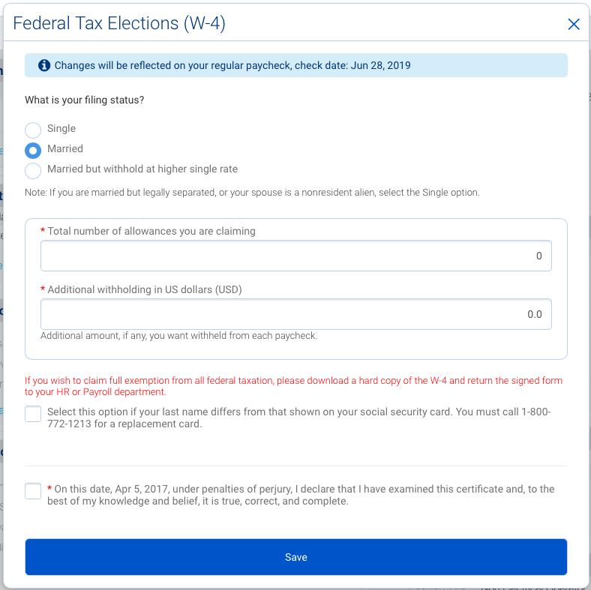
Federal Tax Elections (W-4)

Slide 18
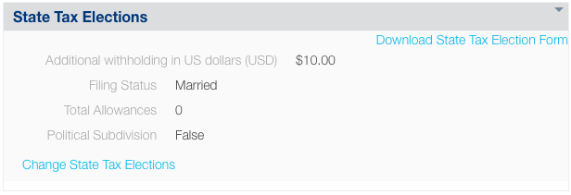
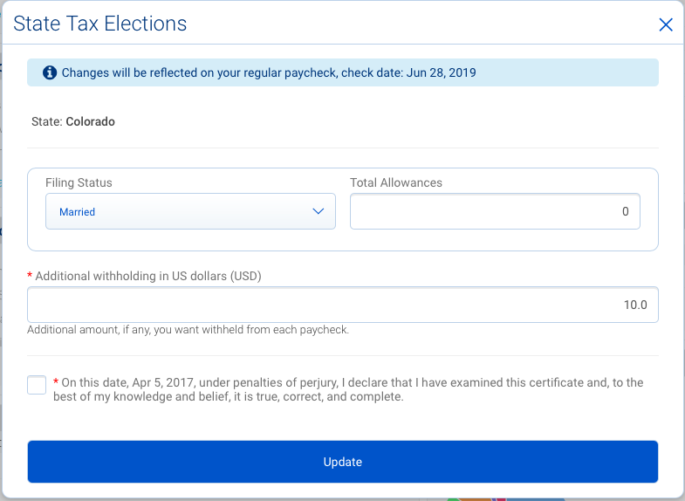
State Tax Elections

Slide 19
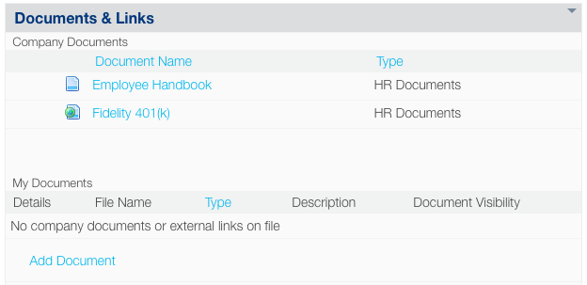
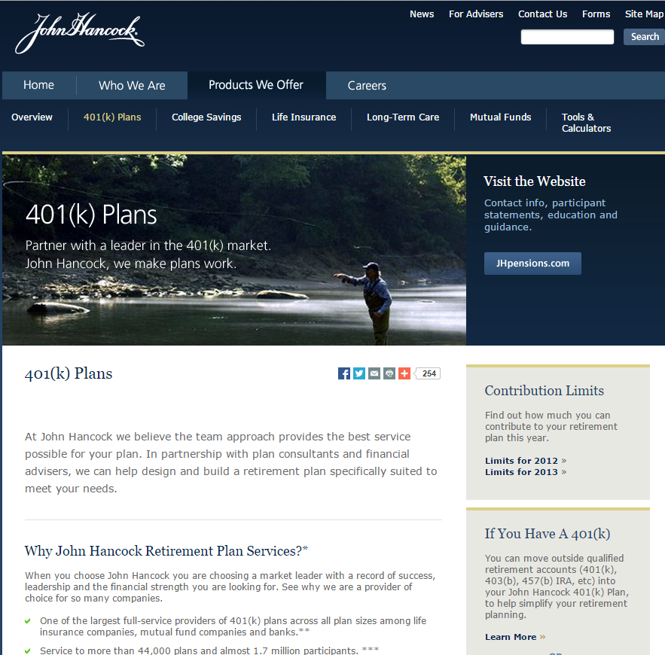
Documents & Links

Slide 20
Paystubs
Provides historical access to pay stubs (once initial payroll is active)
Selecting a pay period link will open the corresponding check stub as a .pdf document.

Slide 21
Total Compensation

Slide 22
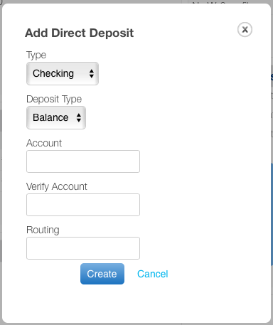
Direct Deposit

Slide 23
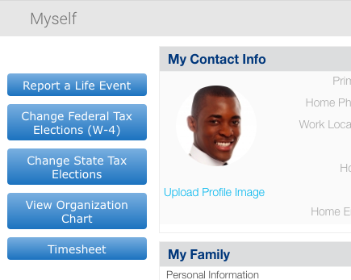
Time Portal Access
To access your time portal, click on Timesheet

Slide 24
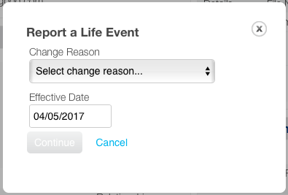
Report a Life Event
Change Reasons include:
Marriage / Domestic Partnership
Divorce / End Domestic Partnership
Birth / Adoption
Loss of Other Coverage
Gained Other Coverage

