Slide 1
Time & Attendance
Employee Guide

Slide 2
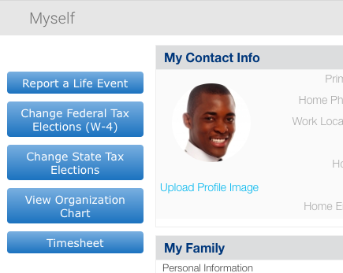
Timesheet Access
Employee Dashboard
Timesheet
To access the Time and Attendance Portal, click on Timesheet on the navigation panel

Slide 3
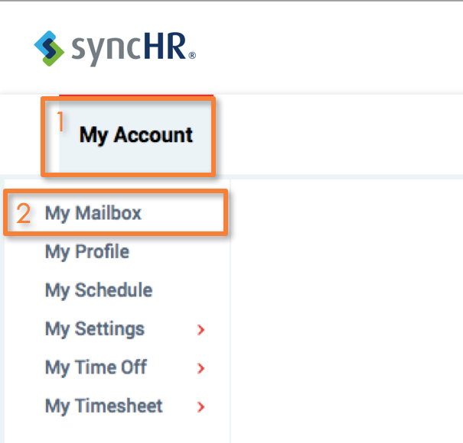
My Mailbox
My Account
My Mailbox
1
To access manager notifications for time off requests, timesheet submissions, and timesheet change requests:
Click My Account
Click My Mailbox
2

Slide 4
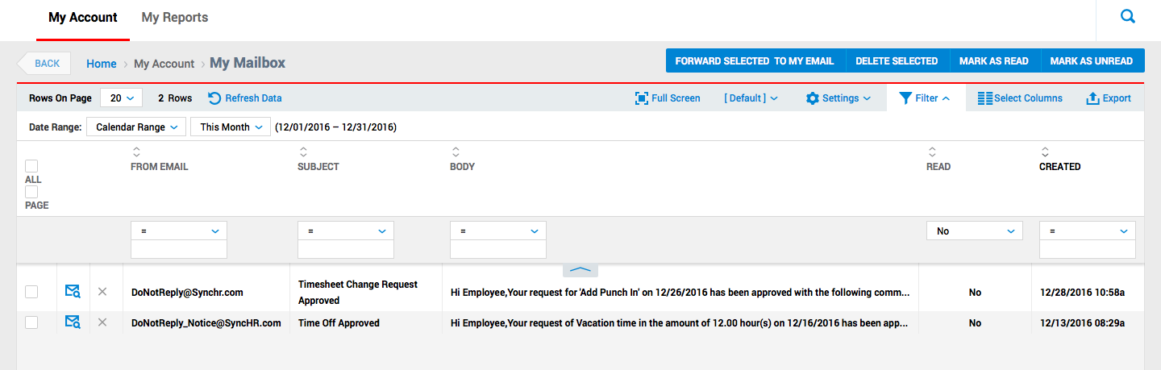
My Mailbox
Click My Account > My Mailbox
Here, you can see notifications relating to time off requests, timesheet change requests, and timesheet approvals.
You can also access through the envelope logo
My Mailbox

Slide 5
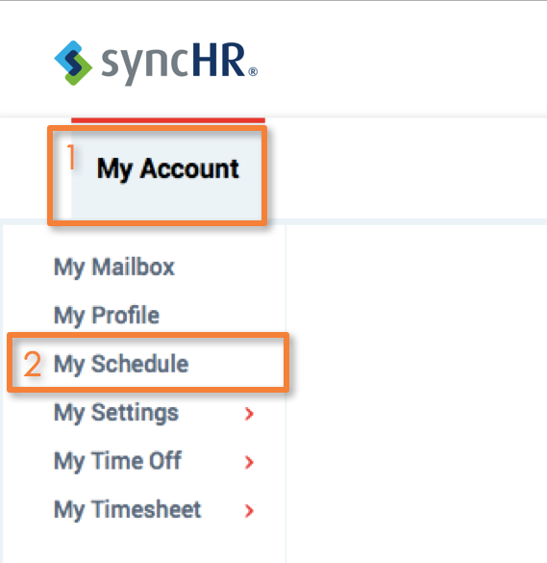
My Schedule
My Account
My Schedule
1
Click My Account
Click My Schedule
2

Slide 6
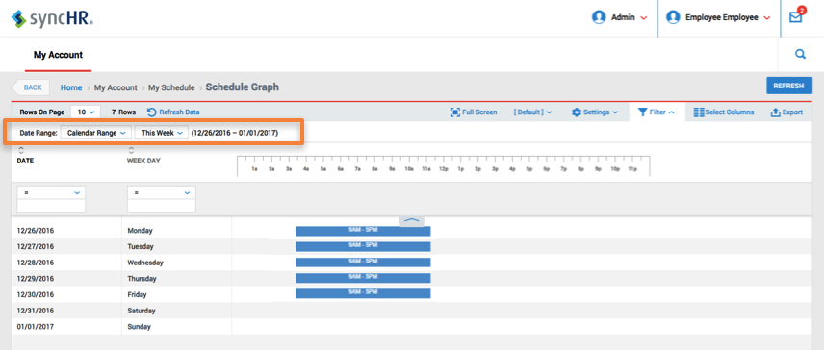
My Schedule
My Account
My Schedule
The screen shows you your schedule
You can filter the range of dates at the top

Slide 7
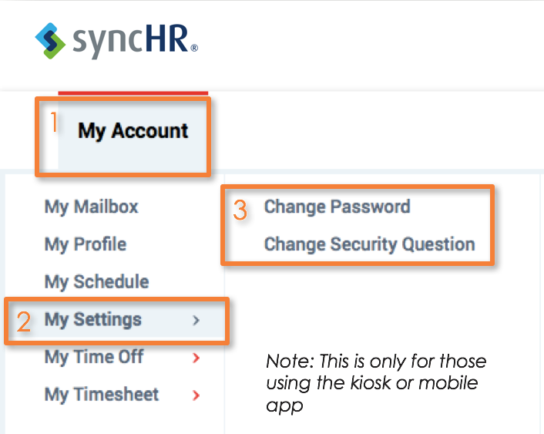
My Settings
My Account
My Settings
1
Here, you can change your password or security questions (ONLY for the Mobile APP)
Click My Account
Click My Settings
Click Change Password or Change Security Question
3
2
Note: This is only for those using the kiosk or mobile app

Slide 8
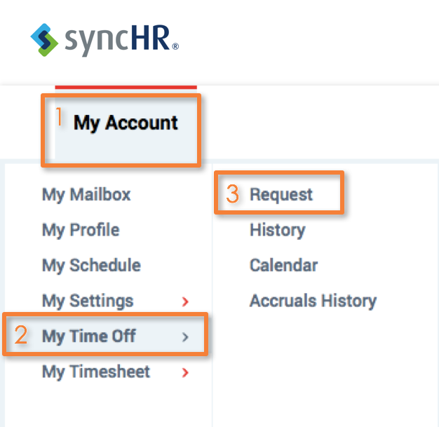
My Time Off
Time Off
1
Requesting Time Off
Click on My Account
Click My Time Off
Click Request
3
2

Slide 9
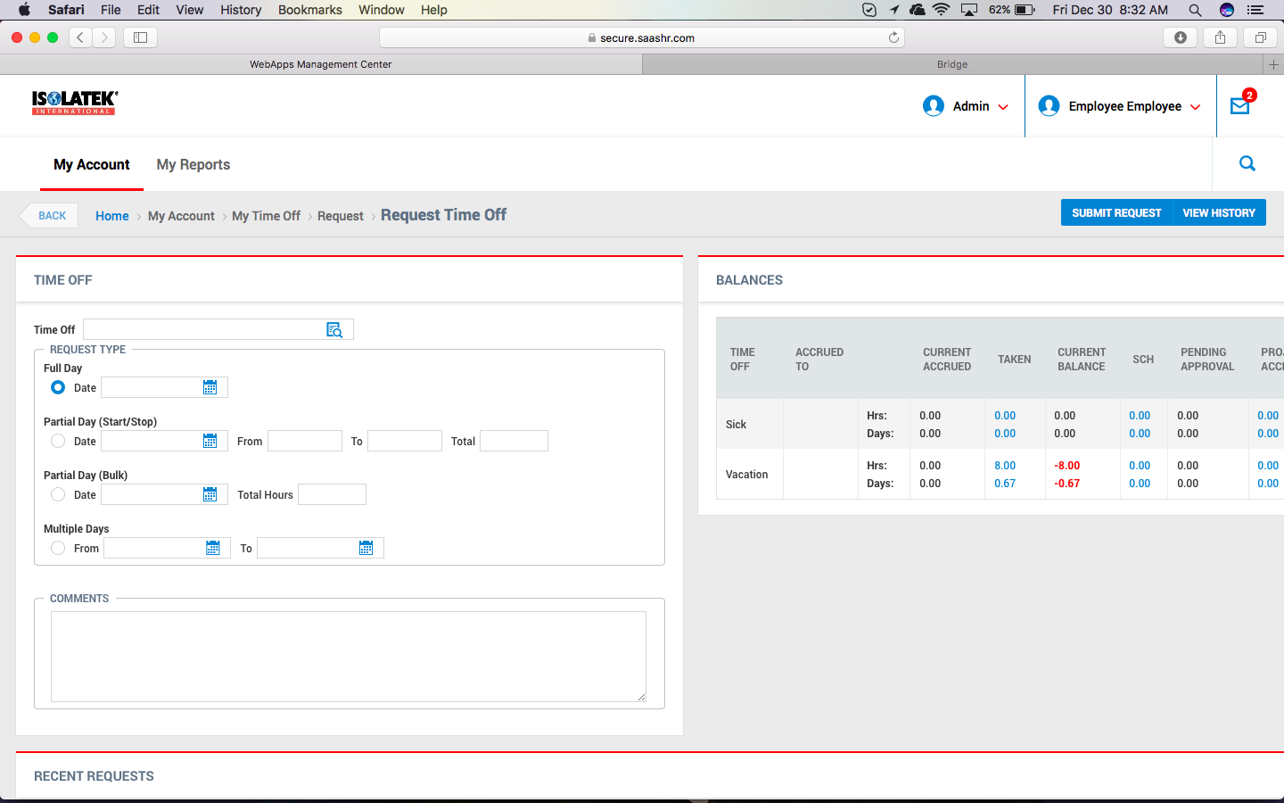
My Time Off
Request Time Off
The screen refreshes:

Slide 10
My Time Off
Request Time Off
Enter details
Enter Time Off Type
Enter Request Type (Full day, Partial Day, Multiple Days)
Enter Comments, if necessary
Submit Request (Note: Pending requests at the bottom of the page)

Slide 11
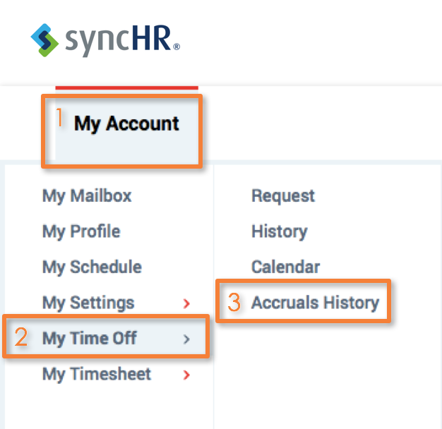
My Time Off
Accruals History
1
How to View your Time Off Balances
Click on My Account
Click My Time Off
Click Accruals History
3
2

Slide 12
My Time Off
Time Off Balances
On the right side of the time off screen, you can view your balance detail

Slide 13
My Time Off
Recent Requests
At the bottom of the Time Off page, recent requests will appear
If a recent request has not been approved, the employee can use the x beside the time off request to cancel if necessary
You can also filter a search of requests by utilizing the fields at the top

Slide 14
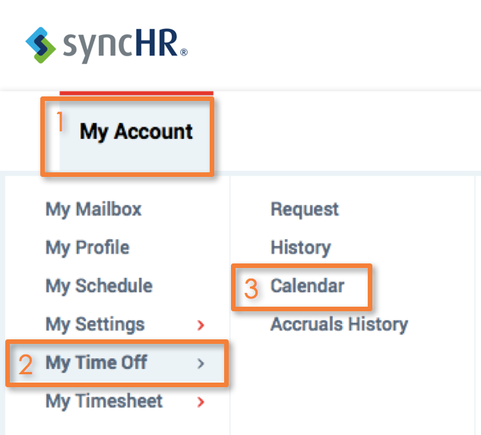
My Time Off
My Account
My Time Off
1
Click My Account
Click My Time Off
Click Calendar
3
2

Slide 15
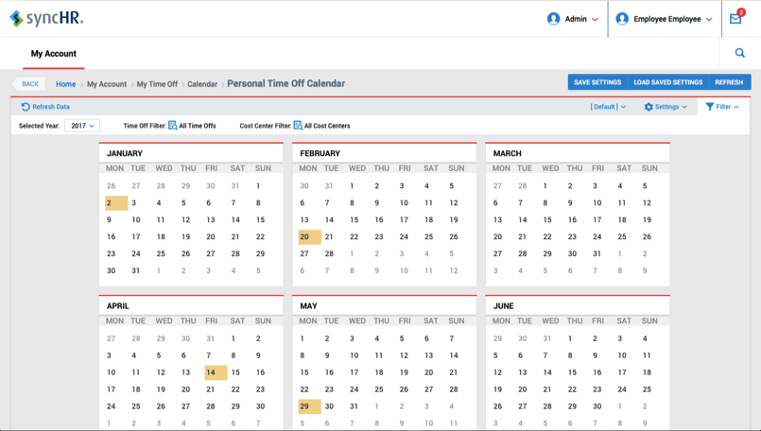
My Time Off
My Account
Calendar
The screen will refresh to show you the company calendar
You can filter by year, approved time off, and cost centers
Click HOME at any time to go back to your Time Sheet

Slide 16
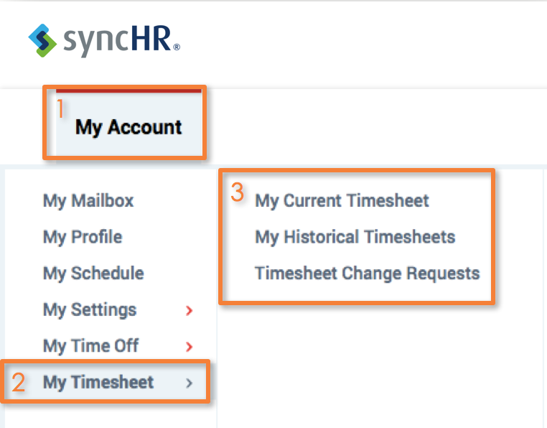
Mt Timesheet
My Account
My Timesheet
1
Click My Account
Click My Timesheet
Here, you can access Current, Historical, or Timesheet Change Requests
3
2

Slide 17
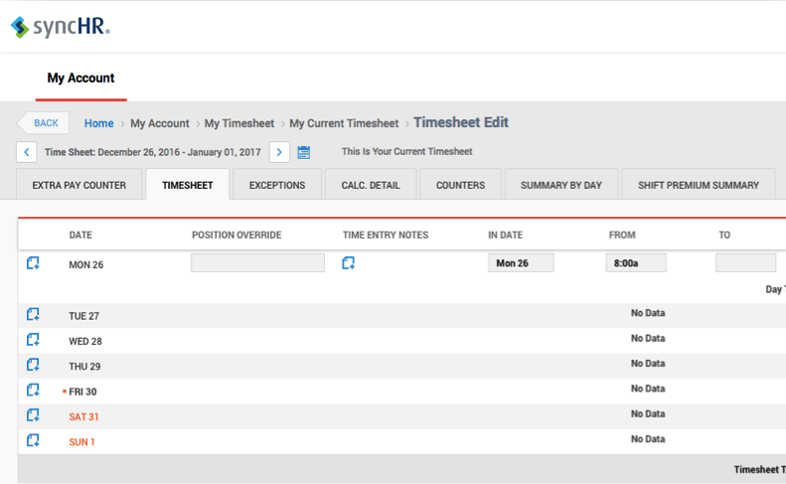
Helpful Navigating Tip
Helpful Tip:
Click your logo or the Home link at the top of the page wherever you are in the system to return to the home page

Slide 18
My Timesheet
Timesheet
Getting to Know Your Timesheet
Date – Shows day
Position Override – Will display the override position the manager has edited to the employee’s profile
Time Off – If there is a company holiday, or you have requested time off, this field will show the entry
Time Entry Notes – Shows any notes that exist about the time entry
In Date – Show the In Date

Slide 19
My Timesheet
Timesheet
Getting to Know Your Timesheet
From – Shows clock in
To – Shows clock out
Raw vs. Calc. Total – Hours actually worked vs. all hours with rules applied
Schedule – Shows actual hours scheduled
Exceptions – Based on client configuration and requires schedules but it can display (Absent, Late In, Early Out, Early In, Late Out, Missed Lunch, etc.)

Slide 20
My Timesheet
Modifying your Time Sheet
1
2
3
4
Add a Note to your manager for the particular day in the pay period
Manager will change the Functional Org, Location or Position Worked if applicable
Add a Note for the pay period
Clock In / Out Times (can be requested to be added/changed via Timesheet Change Requests)

Slide 21
Action Button Definitions
Action Buttons
Defining Actions
Save – Used for saving entries
Undo – Used for undoing an action
Change Requests – Used for submitting a change to your timesheet
Utilities – Timesheet details, audit trail, customized printing
Info – Information about the Time Period

